Slide 1

Default of Credit Card Clients
Subject: Fastag Fraud Detection
Presented By,
Kamran Tariq
Machine Learning project
Fastag Fraud Detection
Machine Laering Internship
Lahore paksitan

Slide 2
AGENDA
Credit Card Default Problem (DEMO)
Problem Overview
Dataset Overview
Data Preparation
Proposed Models
Evaluation
Conclusion

Slide 3
Overview
Banking / Financial Institutes plays a significant role in providing financial service.
To maintain the integrity, bank/institute must be careful when investing in customers to avoid financial loss.
Before giving credit to borrowers, the bank must come to about the potential of customers.
The term credit scoring, determines the relation between defaulters and loan characteristics.

Slide 4
Goal
The model we built here will use all possible factors to predict data on customers to find who are defaulters and non-defaulters next month.
The goal is to find the whether the clients are able to pay their next month credit amount.
Identify some potential customers for the bank who can settle their credit balance.
To determine if their customers could make the credit card payments on-time.
Default is the failure to pay interest or principal on a loan or credit card payment.

Slide 5
Process Design
The process is done by Supervised learning Algorithm.
The idea behind using this is we have a prior knowledge on our output values.
It acts as a guide to teach the algorithms what conclusion it should come up with.
Common algorithms in supervised learning includes logistic regression, naive bayes, support vector machines and decision tree classifier.

Slide 6
Approach Design
Preparation
of data
Applying models
Analyse the Best model
Comparing the applied models
Evaluation Model

Slide 7
Dataset Overview
Oriented: UCI Machine Learning Repository. (Link)
Attributes: 24
Tuples: 30,000
Non-default
Default
Customers data
Non-default
Customers data
Non-default
Non-default

Slide 8
Continue…
Independent variables:
Customer ID
Credit limit
Gender
Age
Marital status
Level of education
History of their past payments made (April to September) (g1 to g6)
Amount of bill statement (h1 to h6)
Amount of previous payment (i1 to i6)
Dependent variables:
default – A customer who will be default next month payment (0: no, 1: yes)

Slide 9
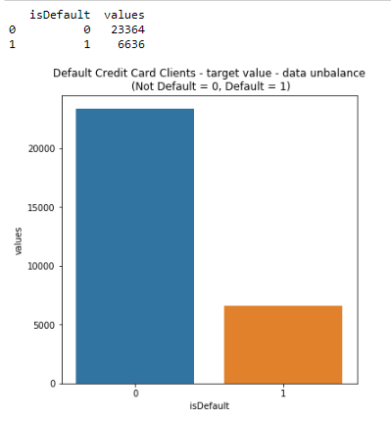
Dataset overview
Graph shows total number of records for defaulters and non-defaulters.
If they would do payment or not (yes=1 no=0) for next month
22% - default
78% - non-default
(Screenshot: Taken during evaluation process)

Slide 10
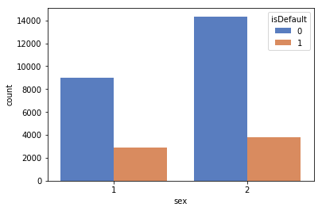
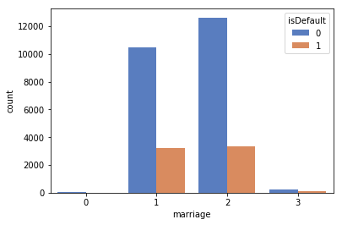
Continue…
1. It shows count for ‘sex’ attribute
1 - Male and 2 - Female
2. It shows default count for ‘marriage’ attribute
0,3 - Others, 1 - Married, 2 - Single
(Screenshot 1,2: Taken during evaluation process)

Slide 11
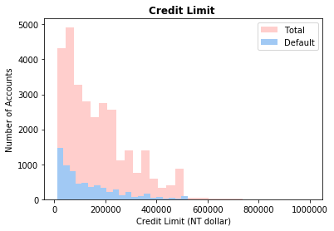
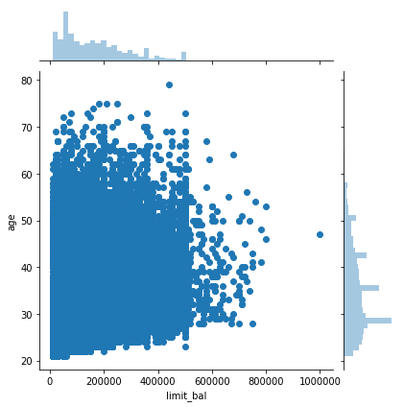
Continue…
1. It shows count for Total ‘Credit limit’ attribute values with respect to Number of Account
2. It shows Limit of balance with respect to age.
(Screenshot 1,2: Taken during evaluation process)

Slide 12
Data Preprocessing
Data set is divided in 60:40 ratio for train and test respectively.
ID column was dropped as its unnecessary for our modeling.
The attribute name ‘PAY_0’ was converted to ‘PAY_1’ for naming convenience.
Pay_0: No consumption of credit card=-2, Pay duly(paid on time)=-1, payment delay for one month=1, payment delay for two months=2, payment delay for nine months and above=9.
Marital Status 0 is converted to value 3 (Others).
No Null values in dataset.
Robust Scaler – It is used to convert variable in the same scale. Ex. in Limit Balance column there are different range of values which are converted in proper scale.

Slide 13
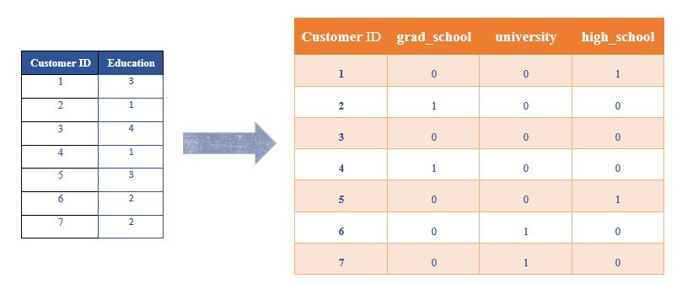
One-Hot Encoding
The process in which Categorical variables are converted into a form, where we can apply algorithms to do prediction easily.
(n-1) features
Ex. There are 4 features in Education → Converted to 3 features (n-1)

Slide 14
Proposed Models
Logistic Regression
Support Vector Machine
Kernel: linear and enabled probability: ‘true’
Soft-SVM search used in the process.
Hard-SVM searches for the decision boundary that separates the training data separately with the largest margin.
Soft-SVM is based on the assumption that learning data is not perfectly separable.

Slide 15
Evaluation Process
Evaluation Metrics:
Accuracy: Accuracy determine how often the model predicts default and non-default correctly.
Precision: Precision calculates whenever our models predicts it is default how often it is correct.
Recall: Recall regulate the actual default that the model is actually predict.
Precision Recall Curve: PRC will display the tradeoff between precision and recall threshold.
Cross Validation:
K Fold cross validation; k = 5

Slide 16
Confusion Metrics
True Positive – A person who is defaulter and predicted as defaulter.
True Negative – A person who is non-defaulter and predicted as non-defaulter.
False Positive – A person who is predicted defaulter is non-defaulter.
False Negative – A person who is predicted non-defaulter is defaulter.
# | Non-defaulter (predicted) - 0 | Defaulter (predicted) - 1
Non-defaulter (actual) - 0 | TN | FP
Defaulter (actual) - 1 | FN | TP

Slide 17
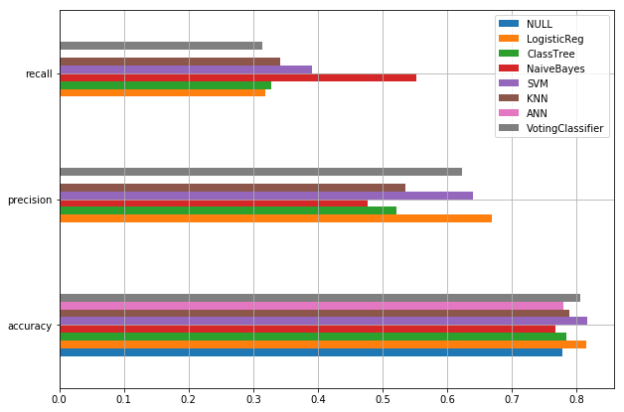
Graphical representation
Bar chart representation of Precision, Recall and Accuracy values

Slide 18
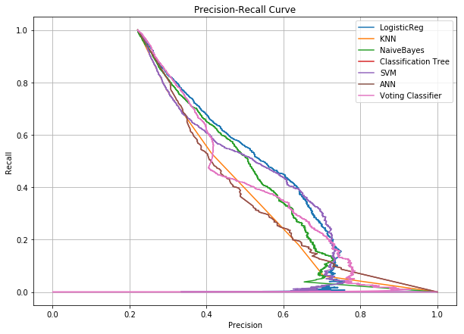
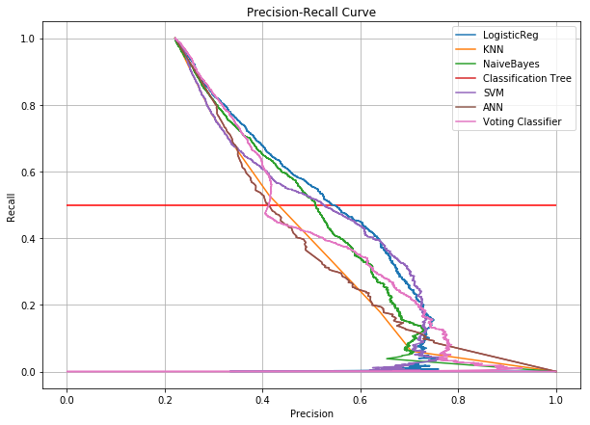
Precision-Recall curve
Comparison of implemented algorithms with Precision-recall curve

Slide 19
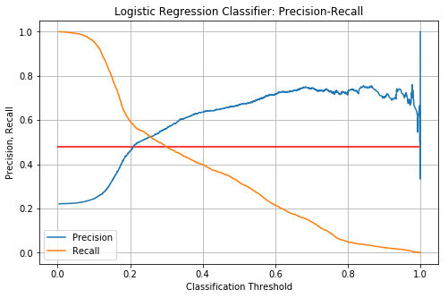
Precision Recall curve with threshold
Precision-Recall comparison with respect to the threshold value.
Adjust precision and recall value by adjusting threshold value
We set threshold value → 0.2
False Negative value is improved by 40%.

Slide 20
Conclusion
We investigated the data, checking for data unbalancing, visualizing the features and understanding the relationship between different features.
We used both train-validation split and cross-validation to evaluate the model effectiveness to predict the target value, i.e. detecting if a credit card client will default next month.
We then investigated five predictive models:
We started with Logistic Regression, Naïve bayes, SVM, KNN, Classification Tree and Feed-forward NN and Voting classifier accuracy is almost same.
We choose based model based on minimum value of False Negative value.
This would also inform the issuer’s decisions on who to give a credit card to and what credit limit to provide.

Slide 21
THANK YOU

